Slide 1




ALDOYT
DATABOT
ARITRA
BHATTACHARYA

Slide 2
OBJECTIVE
USER INPUT
PROCESSING
USER OUTPUT
The user inputs the data on which he/she wants to perform operations. Once the data is uploaded, the user can then type in the question in normal conversations.
The bot converts the question into machine level queries using NLP. It takes the relevant data and performs analysis
The user gets a graphical, informative or geospatial output based on the question which can then be used for further data analysis.

Slide 3
MOTIVATION
EASE OF USAGE
The databot allows the user flexibility to use data in different formats for performing analysis. The use of NLP also allows for the conversion of normal text into machine queries , for performing data analysis using the different inbuilt data visualization options namely statistical, graphical and geospatial.
The current data visualization tools available aren’t that user friendly to use.
The main motivation is to provide user the ability to access sophisticated functionalities without requiring any prior knowledge.
Goal is to develop a messaging software that provides answers to user questions without the need to have any data analytics team.
DATA ANALYSIS USING TECHNOLOGY

Slide 4


TECHNOLOGY
01
03
PYTHON
CHOROPLETH
Use of Python in the backend helps to have a easy adaptability when using the bot for big data analytics
Choropleth helps in the geospatial representation of the data, helping integrate python functionalities for getting a better visual result.
02
04
SEABORN
NATURAL LANGUAGE PROCESSING
Seaborn allows for creation of a wide range of intuitive data visualizations which can help decipher the hidden trends in a more pleasing and efficient manner.
NLP will allow to convert the normal conversational text into machine level queries for the bot to execute operations in the backend.

Slide 5
TRENDS FAVORING DATABOT
REDUCED HUMAN EFFORT
The development of databot makes a interesting proposition as it reduces the cost of ever growing human labor and the associated inaccuracies.
01
04
ALL IN ONE SOLUTION
The bot can be all in one solution for performing different types of analysis on the data thereby making a favorable solution for the masses.
ALDOYT DATABOT
PORTABILITY & ACCESIBILITY
The lightweight and portable nature of the software means it can be easily accessed on any computing device without much hiccups.
02
03
RECOMMENDATIONS
The bot will be able to give better recommendation to the user over time making the whole user interface even more easy to use.

Slide 6
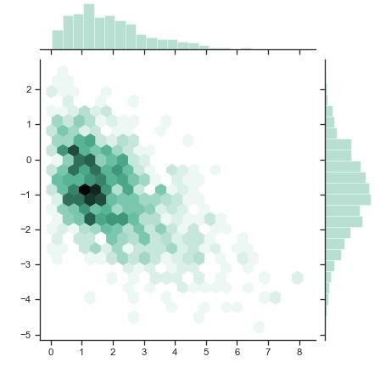
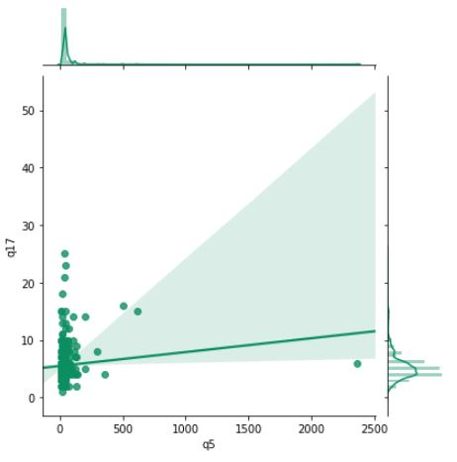
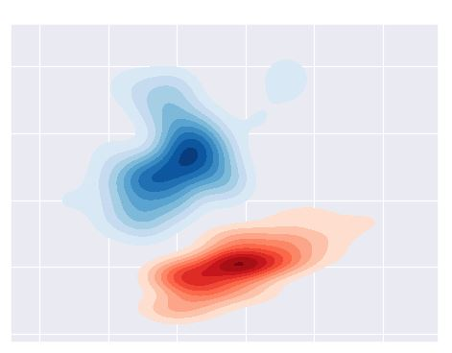
SAMPLE OUTPUTS
HEXBIN PLOT
JOINTPLOT WITH LINEAR REGRESSION
ALDOYT DATABOT
The user can use the bot for a variety of data visualizations. Some examples are shown here.
KERNEL DENSITY PLOT

Slide 7


STATISTICAL OUTPUT
SAMPLE USER INPUT
DATABOT PROCESSING
SAMPLE DATABOT OUTPUT

Slide 8

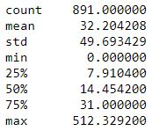
STATISTICAL OUTPUT
SAMPLE USER INPUT
DATABOT PROCESSING
SAMPLE DATABOT OUTPUT

Slide 9
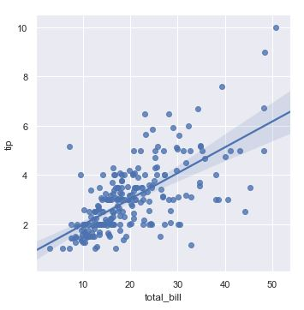
GRAPHICAL OUTPUT
SAMPLE USER INPUT
DATABOT PROCESSING
SAMPLE DATABOT OUTPUT

Slide 10
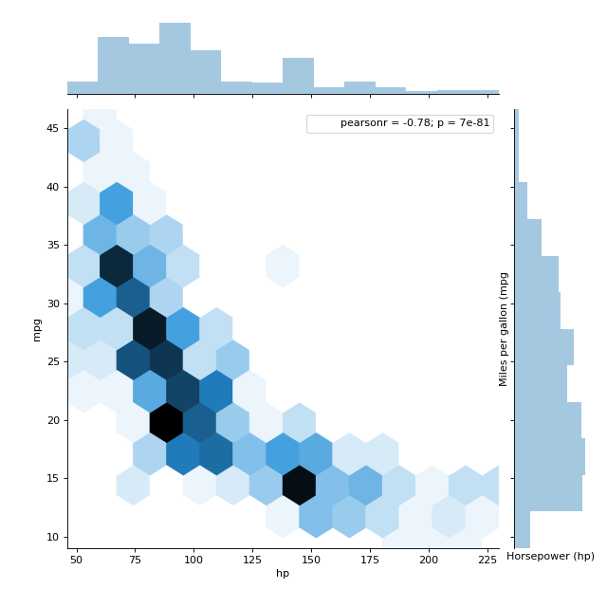
GRAPHICAL OUTPUT
SAMPLE USER INPUT
DATABOT PROCESSING
SAMPLE DATABOT OUTPUT

Slide 11
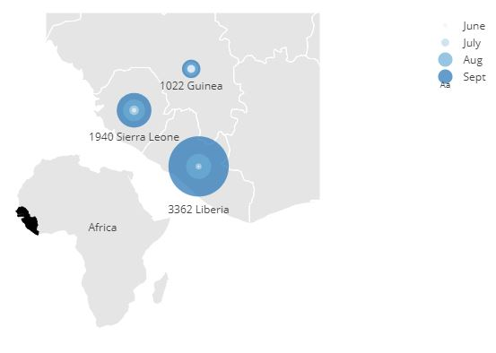
GEOSPATIAL OUTPUT
SAMPLE USER INPUT
DATABOT PROCESSING
SAMPLE DATABOT OUTPUT

Slide 12



THANK YOU

